Slide 1
Identifying Hand Hygiene with Deep Learning
James Edwards
Advisor: Dr. Galluzzi

Slide 2
Motivation
Healthcare
Deep Learning

Slide 3
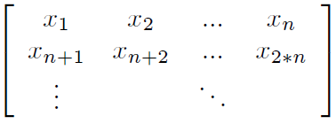
Data
X,Y,Z accelerometer data
100 Hz
Supersampled

Slide 4
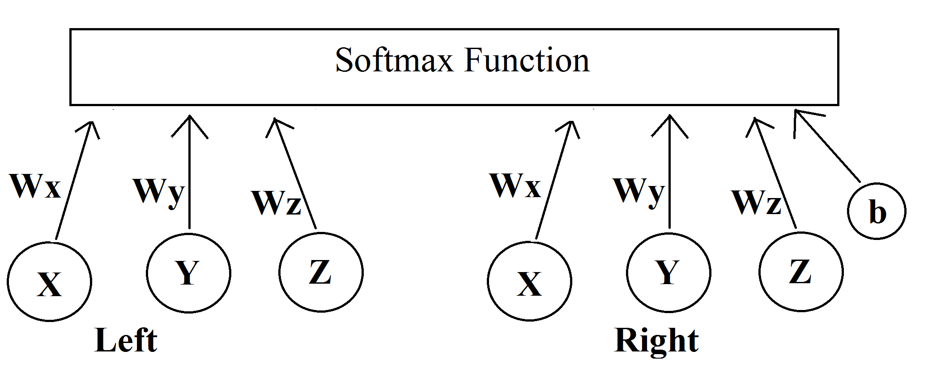
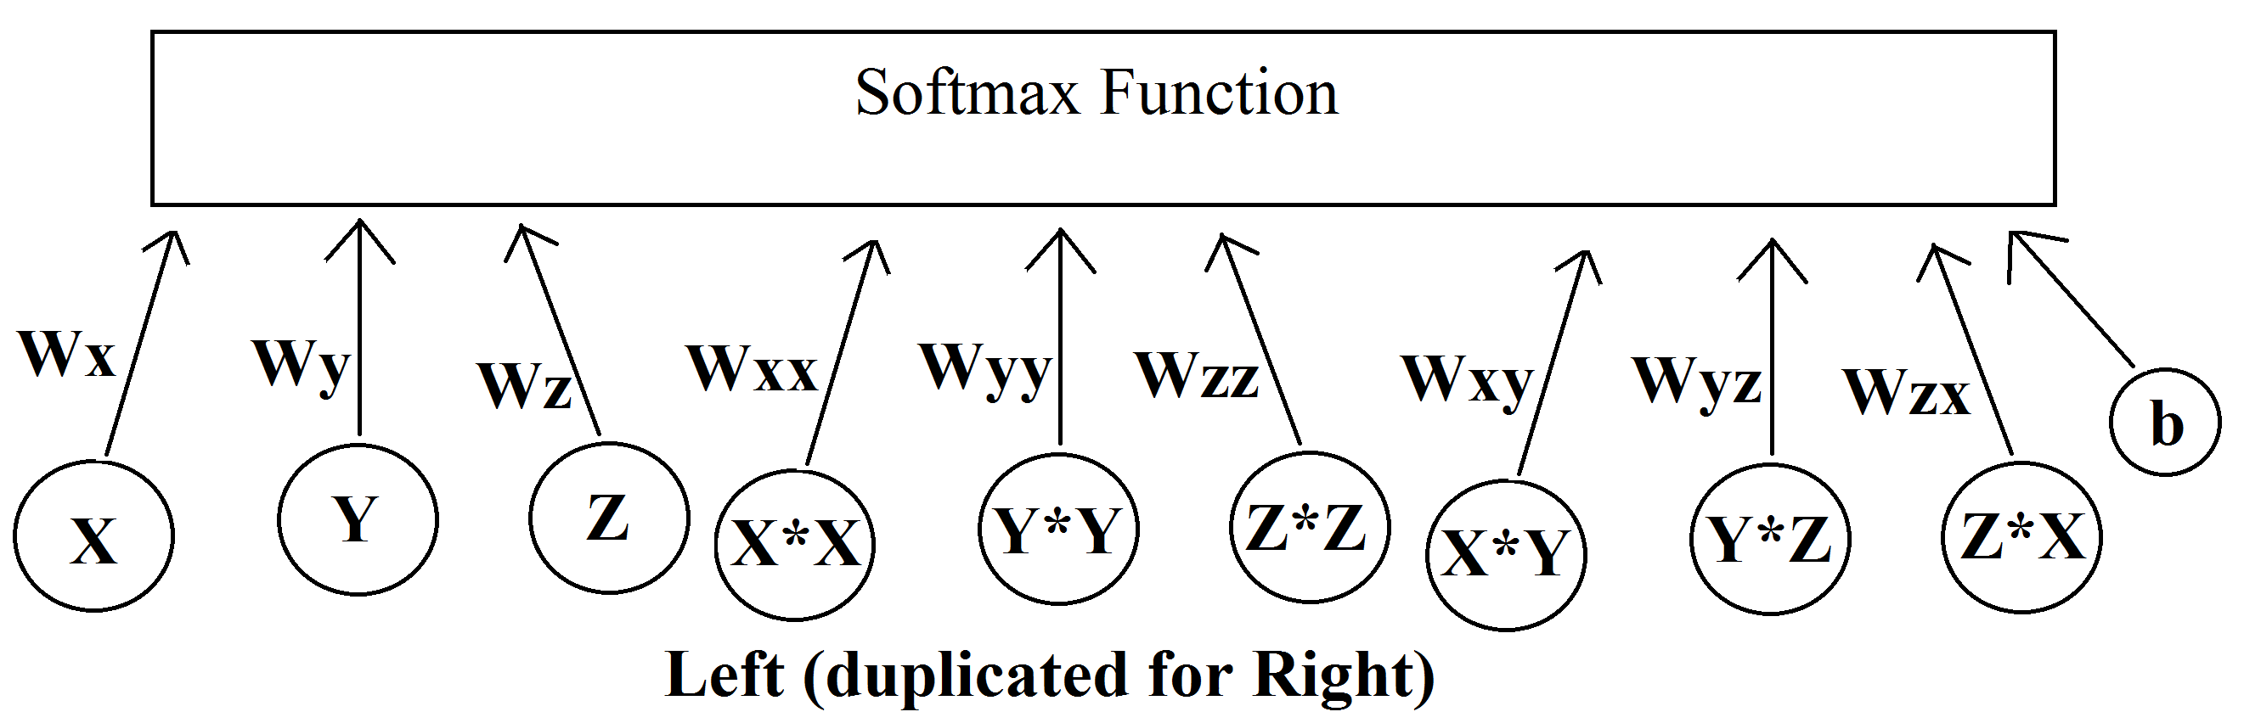
Models
Original
Complex

Slide 5
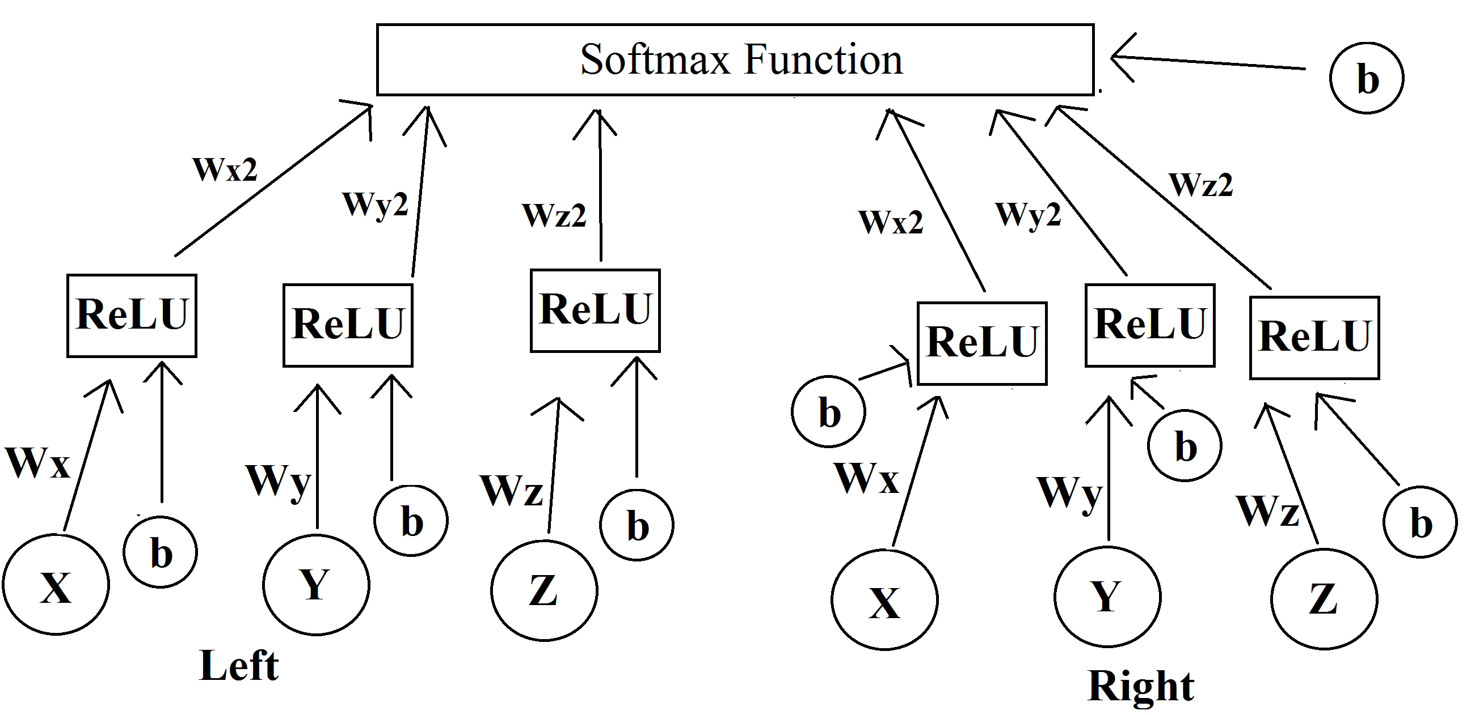
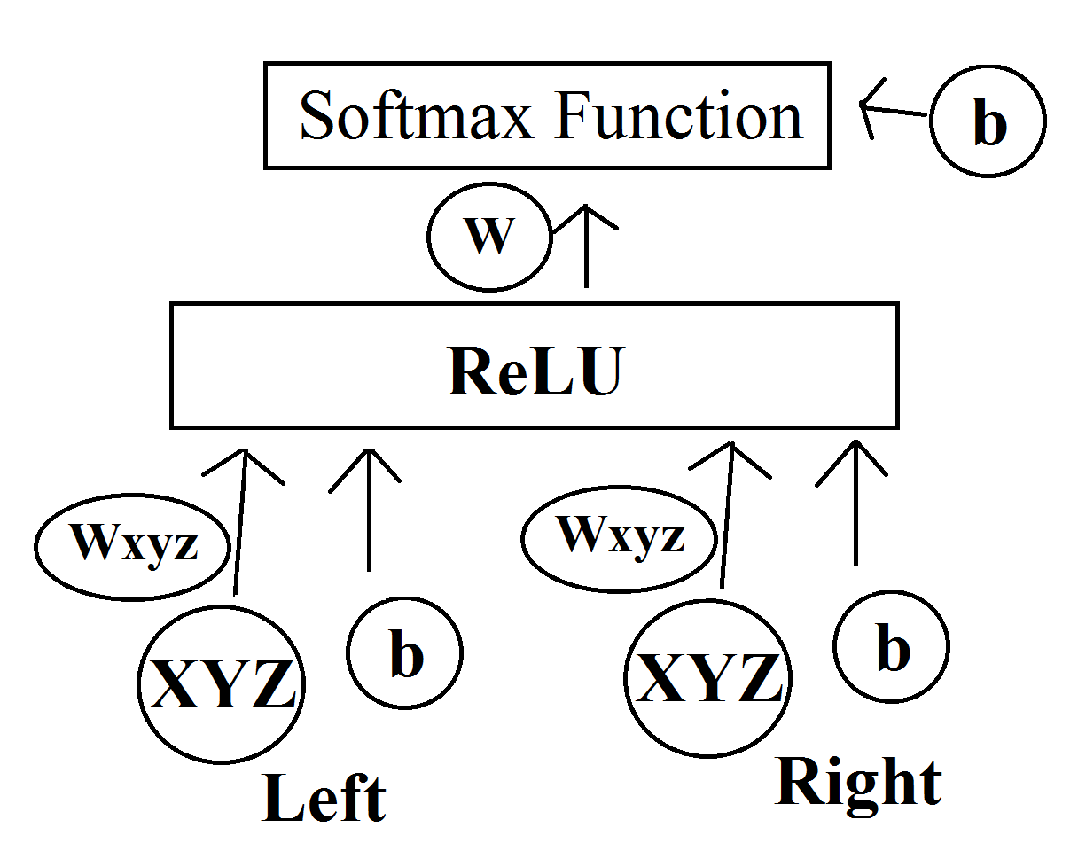
Models
Layered
XYZ

Slide 6
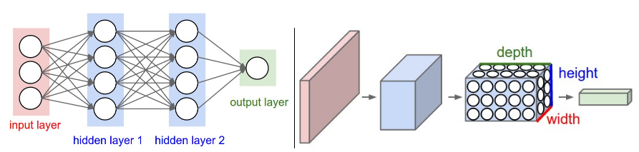
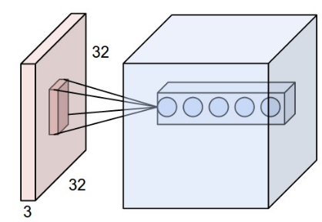
Models
Deep
http://cs231n.github.io/convolutional-networks/

Slide 7
Results
Recall
Accuracy

Slide 8
Results
Deep

Slide 9

Next Steps
Improve Models, Training
Unlabeled Data
Literature Review

Slide 10
Questions?

Slide 11
Handedness

